Slide 1


Introducing Ojas :
Digitizing Ancient Wisdom with Modern Technology
Presented By - TEAM NOVA (T-045)
THEME - HealthTech/FoodTech/AgriTech
Notes:
1

Slide 2
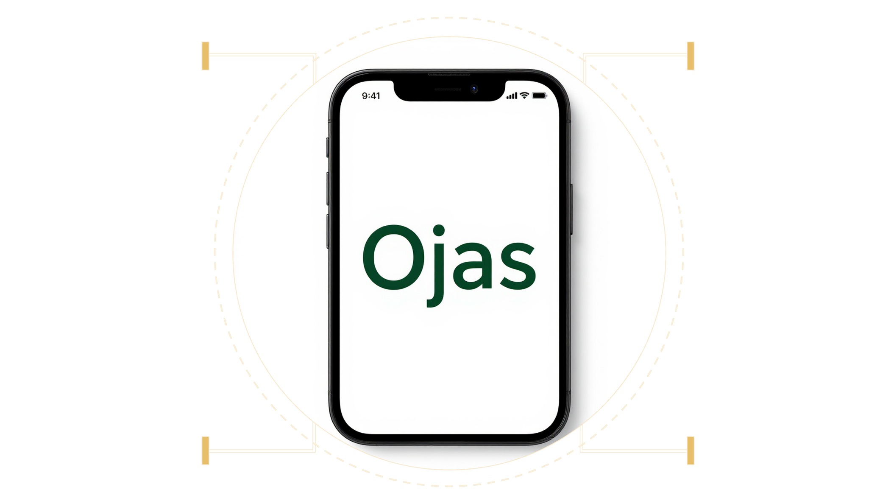
Problem Statement : AyuSutra Panchkarma Patient Management and therapy scheduling Software
Manual Scheduling & Documentation: Leads to errors, delays, and inefficienciey
Inconsistent Therapy Standards: Quality of care varies across different centers
Lack of Digital Patient Management: Difficult to track progress, feedback, or medical history
Limited Communication Channels: Poor coordination between patients and practitioners
Notes:
2

Slide 3


Our solutions to tackle the problem.
Automated Scheduling & Documentation
Digital Patient Management
Enhanced Communication
Ojas app provides automated therapy scheduling with conflict detection, digital documentation, and structured feedback system.
Personalized user profiles to securely store medical history and therapy progress.
In-app messaging, multi-channel notifications (SMS, email, Whatsapp), and reminders improve communication between all users.
Notes:
3

Slide 4

Tech Stack
React Native
Expo
Firebase
Gemini API
Linking
Notes:
4

Slide 5


Ojas: Core Features for Practitioners
Digital Patient Management
Personalised Treatment Plans
Securely store and access comprehensive patient histories, consultations, and progress notes.
Easily create and share customisable Panchakarma and lifestyle recommendations.
Appointment Scheduling
Reminders and Alerts
Timely alerts and remainders to users about their sessions
An intuitive system for managing appointments, reducing no-shows and optimising clinic flow.
Notes:
5

Slide 6

Technology Foundation: Robust & Secure
Modern Tech Stack
Enterprise-Grade Security
Intuitive UI/UX Design
Built with React native, Node.js, firebase for scalable, high-performance operations.
Ensuring data integrity and patient confidentiality between the practitioner and the user.
A mobile-first, accessible design infused with a calming Ayurvedic theme for optimal user experience.
Cross-Device Responsiveness
Optimized for a consistent and fluid experience across all devices: mobile, tablet, and desktop.
Notes:
6

Slide 7
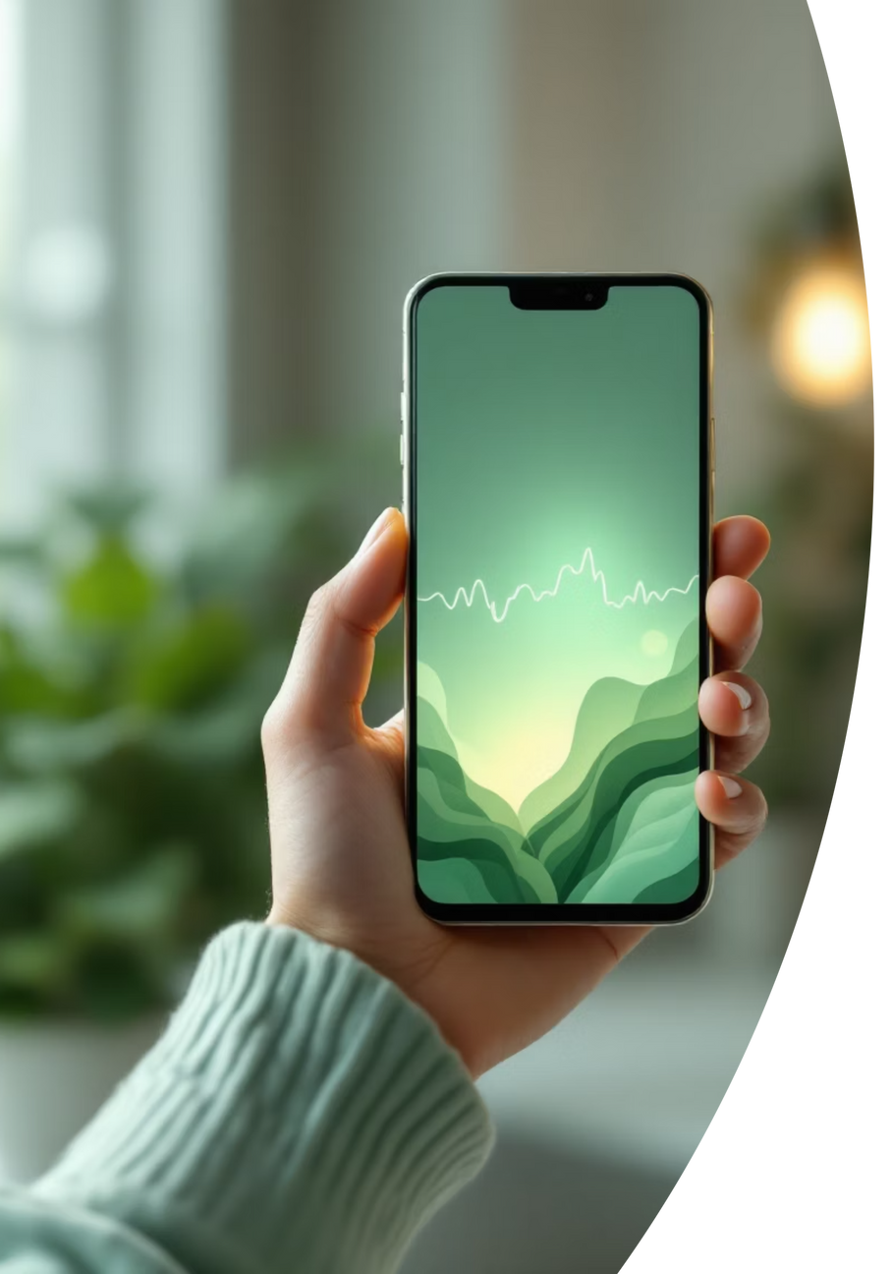
Future Scope of Ojas: Pioneering Innovation
AI-Driven chatbot
1
Personalised Panchakarma plans based on patient data trends.
Premium Features
2
Premium users will get personalised diet plans, exercises and many more.
Tele-consultation
3
Video calls and remote therapy guidance within the app.
Language Expansion
4
More regional languages for wider accessibility.
Automated Whatsapp Chats
5
User will get Automated answers in whatsapp.
Notes:
7

Slide 8




Meet the Visionaries Behind Ojas "Team NOVA"
Our dedicated and talented team brings together diverse expertise to bridge ancient Ayurvedic wisdom with cutting-edge technology, driving the mission of Ojas forward.
Mehak
Danish
Simon Paul
Team Leader
Team Member
Team Member
Komal
Ravinder
Team Member
Team Member
Notes:
8

Slide 9

Thank You
Notes:
9

